Slide 1
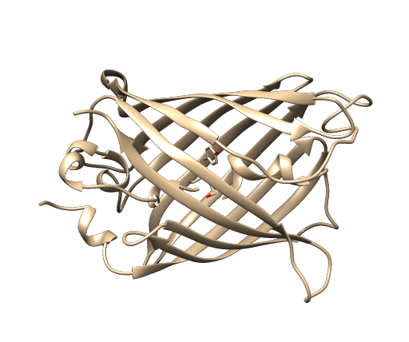
49-206402 荒木涼之介

Slide 2
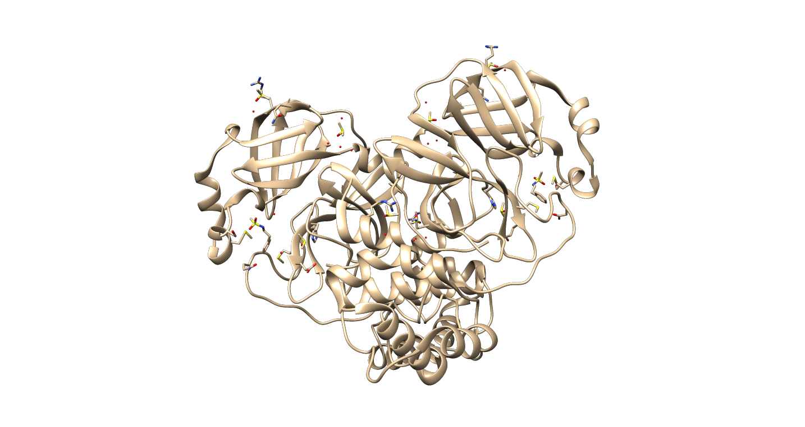
5R7Y
SARS-CoV-2 main protease
X-RAY DIFFRACTION

